Slide 1
Lecture-2
Eigenvalues & Eigenvectors

Slide 2
Objective:
How to solve system of differential equation
Methodology:
We will solve system of differential equation with the help eigenvalue and eigenvector

Slide 3
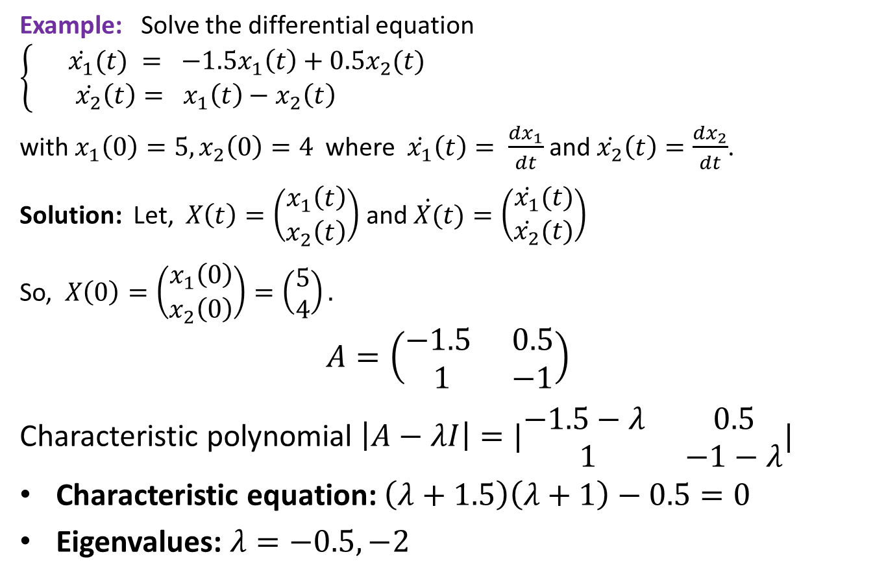
Solving system of differential equation
Example: Solve the differential equation $\left\{\begin{aligned} \dot{x_{1}}(t) = −1.5x_{1}\left(t\right)+{0.5x}_{2}(t) \\ \dot{x_{2}}\left(t\right)= x_{1}\left(t\right)−x_{2}\left(t\right) \end{aligned}\right.$
with$x_{1}\left(0\right)=5, x_{2}\left(0\right)=4$where $\dot{x_{1}}\left(t\right)= \frac{dx_{1}}{dt}$ and $\dot{x_{2}}\left(t\right)=\frac{dx_{2}}{dt}$.
Solution: Let, $X\left(t\right)=\left(\begin{matrix}x_{1}\left(t\right) \\ x_{2}\left(t\right)\end{matrix}\right)$ and $\dot{X(}t)=\left(\begin{matrix}\dot{x_{1}}(t) \\ \dot{x_{2}}(t)\end{matrix}\right)$
So, $X\left(0\right)=\left(\begin{matrix}x_{1}\left(0\right) \\ x_{2}\left(0\right)\end{matrix}\right)=\left(\begin{matrix}5 \\ 4\end{matrix}\right).$
$$A=\left(\begin{matrix}−1.5 & 0.5 \\ 1 & −1\end{matrix}\right)$$
Characteristic polynomial $\left|A−λI\right|=|\begin{matrix}−1.5−λ & 0.5 \\ 1 & −1−λ\end{matrix}|$
Characteristic equation: $\left(λ+1.5\right)\left(λ+1\right)−0.5=0$
Eigenvalues: $λ=−0.5,−2$

Slide 4
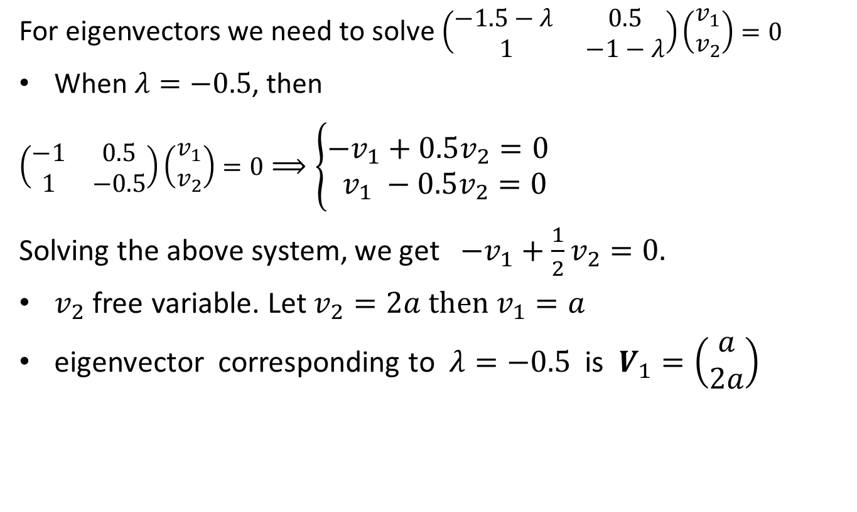
Finding eigenvectors
For eigenvectors we need to solve $\left(\begin{matrix}−1.5−λ & 0.5 \\ 1 & −1−λ\end{matrix}\right)\left(\begin{matrix}v_{1} \\ v_{2}\end{matrix}\right)=0$
When $λ=−0.5$, then
$\left(\begin{matrix}−1 & 0.5 \\ 1 & −0.5\end{matrix}\right)\left(\begin{matrix}v_{1} \\ v_{2}\end{matrix}\right)=0⟹\left\{\begin{aligned}−v_{1}+0.5v_{2}=0 \\ v_{1} −0.5v_{2}=0 \end{aligned}\right.$
Solving the above system, we get $−v_{1}+\frac{1}{2}v_{2}=0.$
$v_{2}$ free variable. Let $v_{2}=2a then$ $v_{1}=a$
eigenvector corresponding to $λ=−0.5$ is $V_{1}=\left(\begin{matrix}a \\ 2a\end{matrix}\right)$

Slide 5
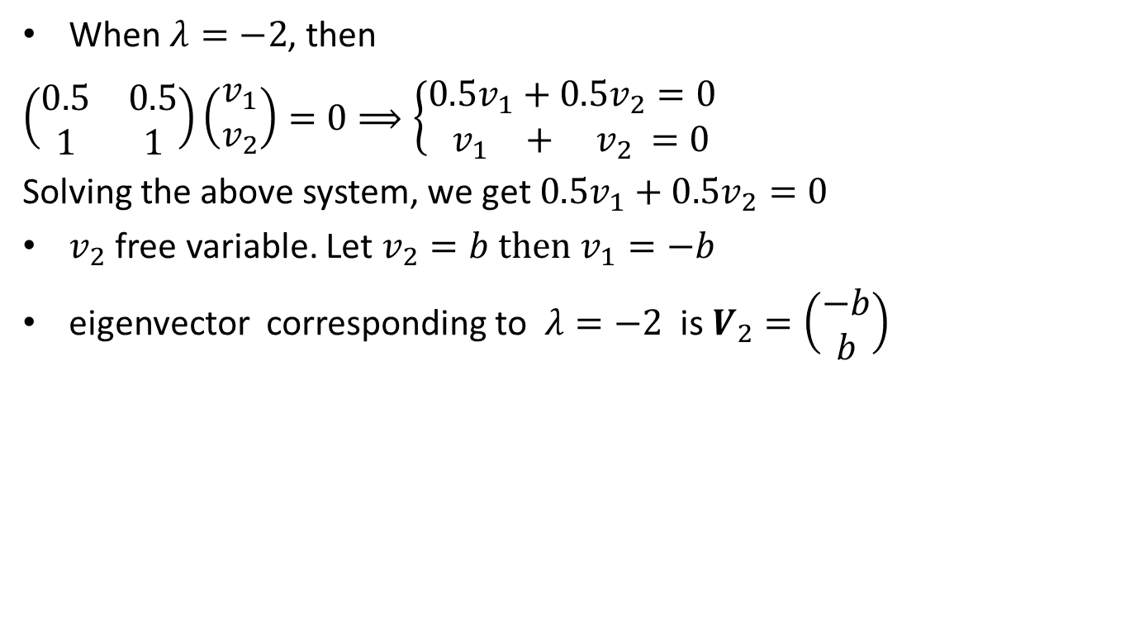
Finding eigenvectors(continued)
When $λ=−2$, then
$\left(\begin{matrix}0.5 & 0.5 \\ 1 & 1\end{matrix}\right)\left(\begin{matrix}v_{1} \\ v_{2}\end{matrix}\right)=0⟹\left\{\begin{aligned}0.5v_{1}+0.5v_{2}=0 \\ v_{1 } + { v}_{2} =0 \end{aligned}\right.$
Solving the above system, we get$0.5v_{1}+0.5v_{2}=0$
$v_{2}$ free variable. Let $v_{2}=b then$ $v_{1}=−b$
eigenvector corresponding to $λ=−2$ is $V_{2}=\left(\begin{matrix}−b \\ b\end{matrix}\right)$

Slide 6
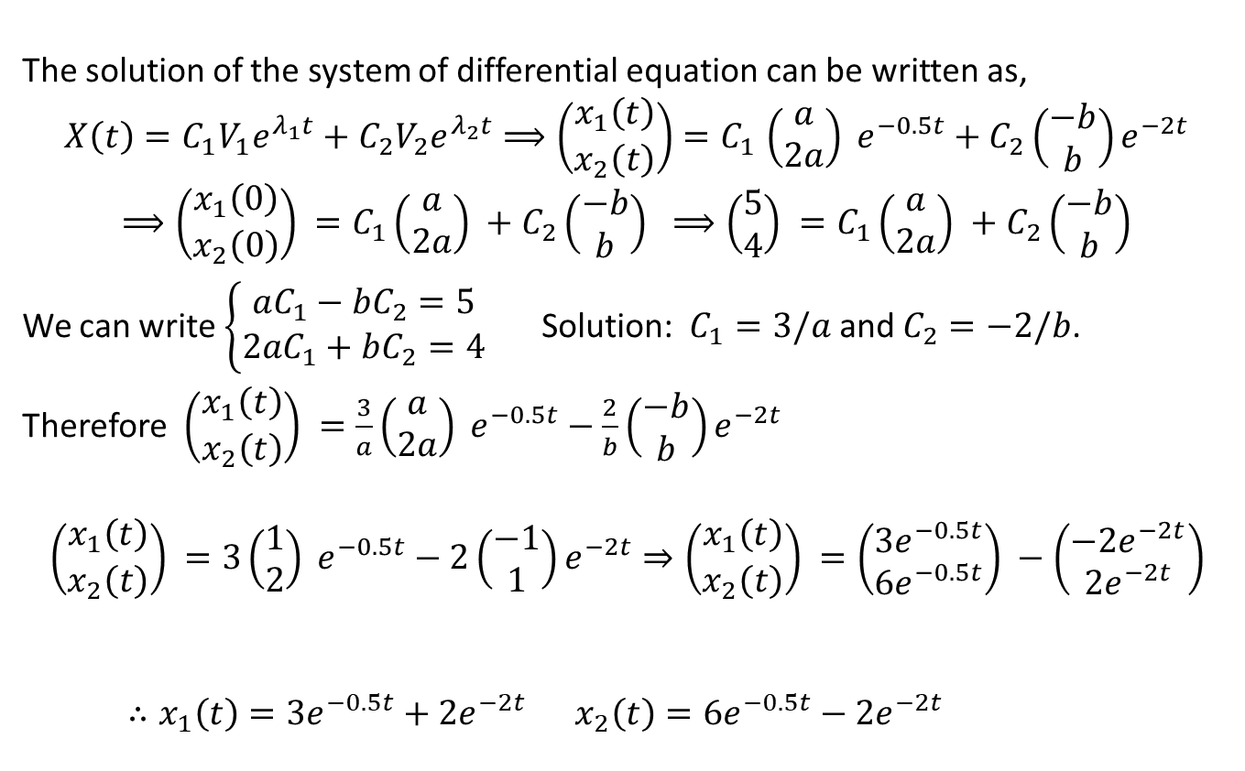
Finding solutions of the system
The solution of the system of differential equation can be written as,
$$X\left(t\right)=C_{1}V_{1}e^{λ_{1}t}+C_{2}V_{2}e^{λ_{2}t}⟹\left(\begin{matrix}x_{1}\left(t\right) \\ x_{2}\left(t\right)\end{matrix}\right){=C}_{1}\left(\begin{matrix}a \\ 2a\end{matrix}\right) e^{−0.5t}+C_{2}\left(\begin{matrix}−b \\ b\end{matrix}\right)e^{−2t}$$
$$⟹\left(\begin{matrix}x_{1}\left(0\right) \\ x_{2}\left(0\right)\end{matrix}\right) =C_{1}\left(\begin{matrix}a \\ 2a\end{matrix}\right) +C_{2}\left(\begin{matrix}−b \\ b\end{matrix}\right) ⟹\left(\begin{matrix}5 \\ 4\end{matrix}\right) =C_{1}\left(\begin{matrix}a \\ 2a\end{matrix}\right) +C_{2}\left(\begin{matrix}−b \\ b\end{matrix}\right)$$
We can write $\left\{\begin{aligned}aC_{1}−{bC}_{2}=5 \\ {2aC}_{1}+bC_{2}=4 \end{aligned}\right.$ Solution: $C_{1}=3/a$ and $C_{2}=−2/b$.
Therefore $\left(\begin{matrix}x_{1}\left(t\right) \\ x_{2}\left(t\right)\end{matrix}\right) =\frac{3}{a}\left(\begin{matrix}a \\ 2a\end{matrix}\right) e^{−0.5t}−\frac{2}{b}\left(\begin{matrix}−b \\ b\end{matrix}\right)e^{−2t}$
$$\left(\begin{matrix}x_{1}\left(t\right) \\ x_{2}\left(t\right)\end{matrix}\right) =3\left(\begin{matrix}1 \\ 2\end{matrix}\right) e^{−0.5t}−2\left(\begin{matrix}−1 \\ 1\end{matrix}\right)e^{−2t}⇒\left(\begin{matrix}x_{1}\left(t\right) \\ x_{2}\left(t\right)\end{matrix}\right) =\left(\begin{matrix}3e^{−0.5t} \\ 6e^{−0.5t}\end{matrix}\right) −\left(\begin{matrix}−2e^{−2t} \\ 2e^{−2t}\end{matrix}\right)$$
$∴x_{1}\left(t\right)=3e^{−0.5t}+2e^{−2t}$ $x_{2}\left(t\right)=6e^{−0.5t}−2e^{−2t}$

Slide 7
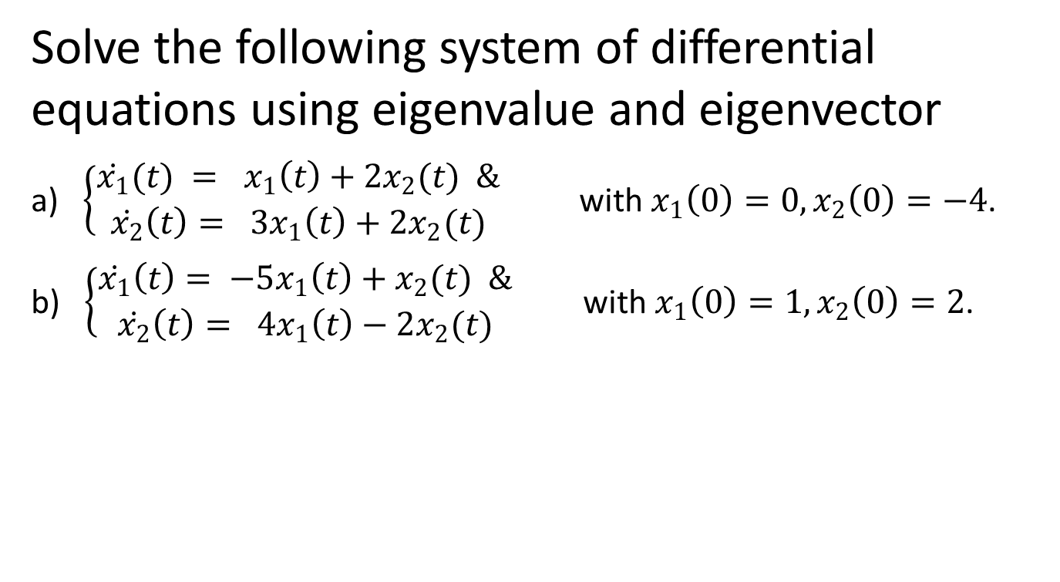
Sample Question
Solve the following system of differential equations using eigenvalue and eigenvector
a) $\left\{\begin{aligned}\dot{x_{1}}(t) = x_{1}\left(t\right)+{2x}_{2}(t) & \\ \dot{x_{2}}\left(t\right)= 3x_{1}\left(t\right)+{2x}_{2}(t)\end{aligned}\right.$with$x_{1}\left(0\right)=0, x_{2}\left(0\right)=−4$.
b) $\left\{\begin{aligned}\dot{x_{1}}\left(t\right)= −5x_{1}\left(t\right)+x_{2}(t) & \\ \dot{x_{2}}\left(t\right)= 4x_{1}\left(t\right)−2x_{2}(t)\end{aligned}\right.$with$x_{1}\left(0\right)=1, x_{2}\left(0\right)=2$.

Slide 8
Outcome
After this lecture students
Will know how to solve system of differential equation using eigenvalues and eigenvectors.

Slide 9
Next class
Cayley-Hamilton theorem

